Slide 1

RESIDENT ENERGY USAGE PATTERNS
Analysis
- Michael Bauler 01.15.2021

Slide 2
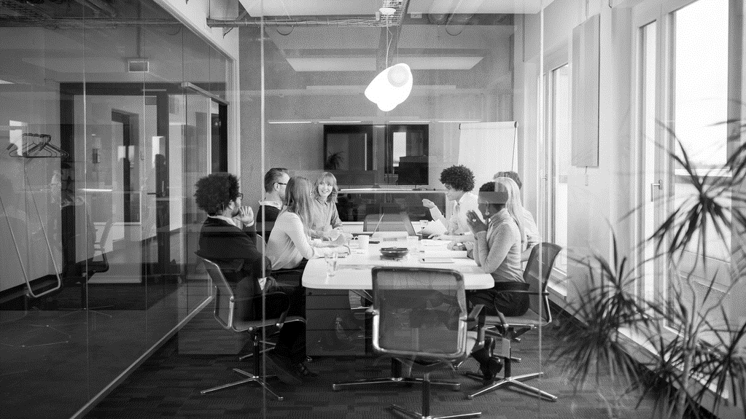
Background/objective
A law firm needs help analyzing archived data records for their client.
We have been tasked with proving or disproving the clients claim that they were not occupying a specific residence at the time of an undisclosed event during the Summer of 2008

Slide 3
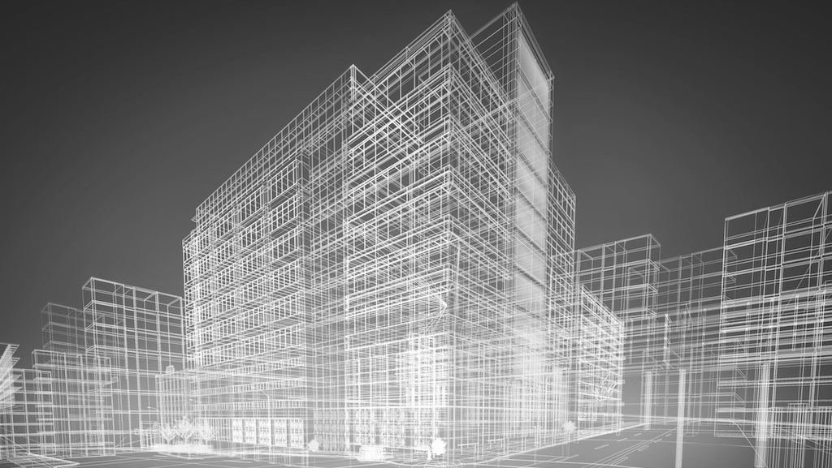
Overview – what are submeters?
Submeters are utility-grade power meters installed between the master utility meter & individual units.
They allow each tenant to be billed only for the energy consumed within the rented space.
They show the power usage of each tenant

Slide 4
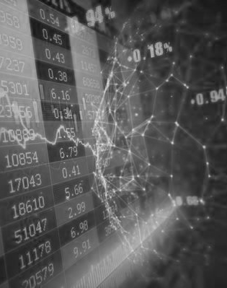
The data
On SQL Server password protected for security reasons
Consists of energy consumed for 3 different sub-meters in residential home in Seaux, France between Dec. 06’ and Nov. 10’ (47 months, over 2 million minute observations)
SubMeter1 = kitchen, dishwasher, oven and microwave
SubMeter2 = laundry room, washing-machine, drier, fridge and a light
SubMeter3 = Water Heater + AC

Slide 5
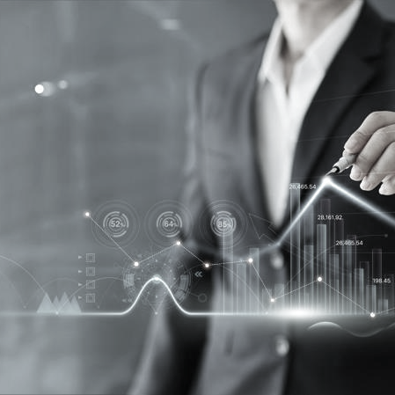
data issues
2006 = 2 weeks of data
2010 = 11 months of data
Date / Time format
Time Zone (France)

Slide 6
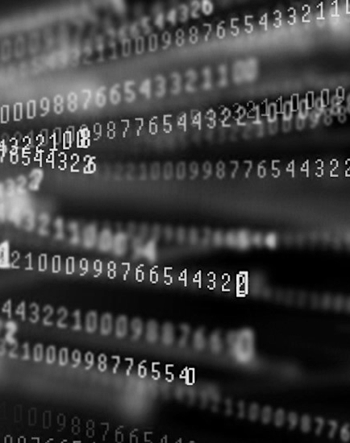
DATA processing
Remove irrelevant data
Only include full years (2007, 2008 & 2009)
Convert Date/Time to a usable data
Missing data/time (Ea. day equals 1440 min)
Account for France Time zone

Slide 7
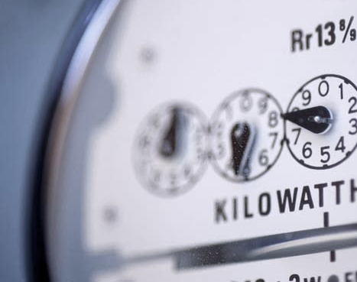
energy usage summary
Sub1: Kitchen
Least total energy used (1,819,989 Watts)
Average 1.16 Watts per minute
Largest energy range (0-82 Watts)
Sub2: Laundry
Total energy used (2,108,410 Watts)
Average 1.34 Watts per minute
Energy range (0-78 Watts)
Sub3: Water Heater & AC
Most total energy used (9,758,843 Watts)
Average 6.21 Watts per minute
Smallest energy range (0-32 Watts)

Slide 8
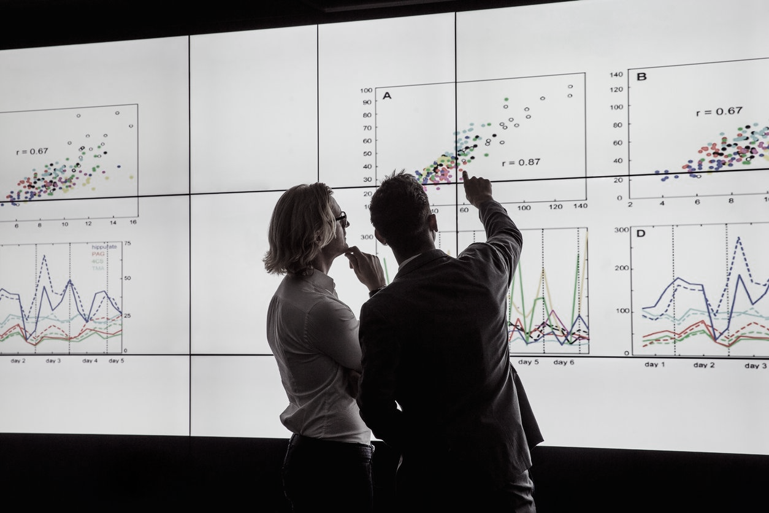

observations
Only a total of4 min are missing from 3 dates of concern (Summer 2008 June 21 – Sept.22)
07/13/08 – 1438 min
08/04/08 – 1439 min
08/31/08 – 1439 min
SubMeter1 (Kitchen) uses least energy
SubMeter3 (AC + Heater) uses most energy
SubMeter3 uses 4x the energy of the next highest SubMeter (SubMeter2)

Slide 9
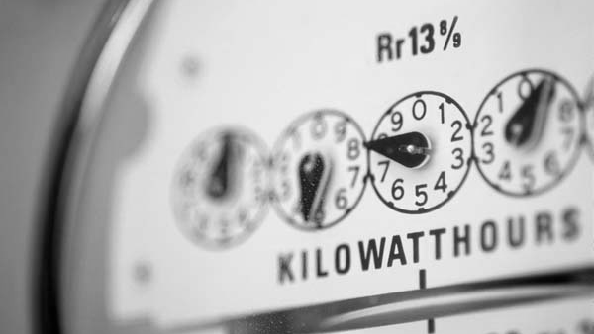
recommendations
Provide data set of neighbors in order to compare typical power use of other residents
Move part of sub2 (laundry) which includes the refrigerator to sub1 (kitchen)
Energy saving tips
AC + Heater settings – Set to 68° or cooler in Winter, 78° or warmer in Summer
Set AC fan to Auto
Regularly replace AC filter
Water for washing machine – make sure water level matches level of load
Always use the Cold Rinse option

Slide 10

Thank you
Any questions?
- Michael Bauler 01.15.2021

